Slide 1
California Energy Commission
Title: Compliance Rate Study – AHJ Database Update
Presenter: Robert Ford, Associate Energy Specialist
Date: June 2025

Slide 2

Purpose and Benefits
California has funds from the federal government to improve compliance with the state's Energy Code
AHJs are resource-constrained and require additional assistance
Benefits Californians by improving relations between local governments and state agencies
Increases transparency of state agencies' data collection, code compliance, and code enforcement efforts

Slide 3
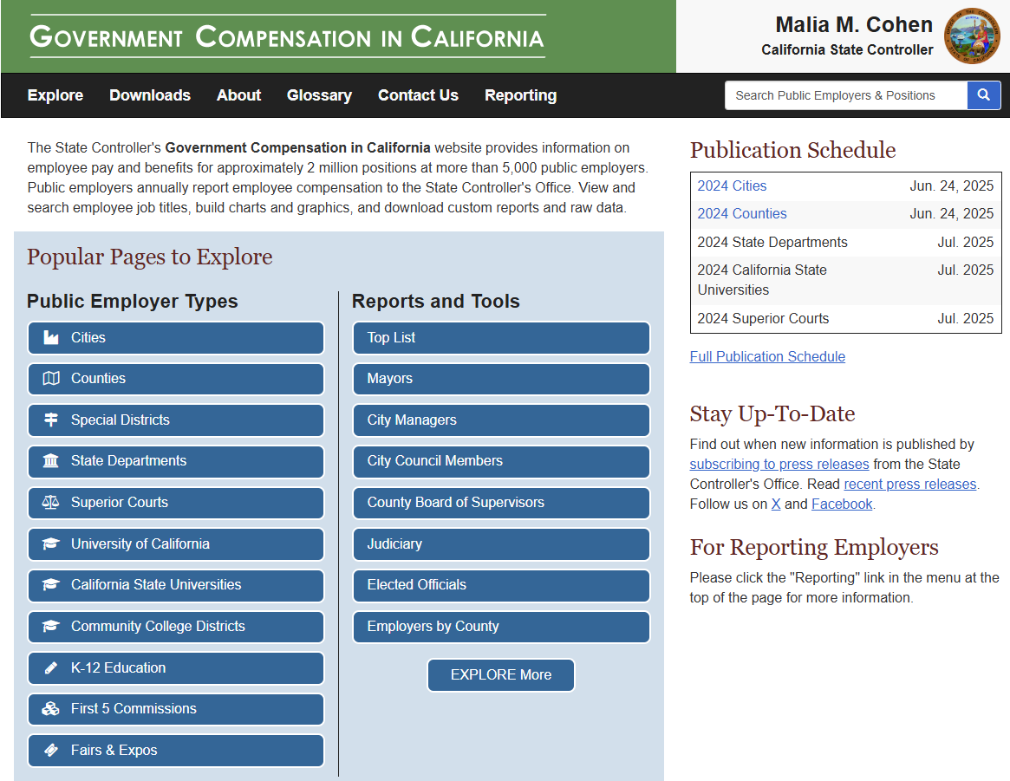
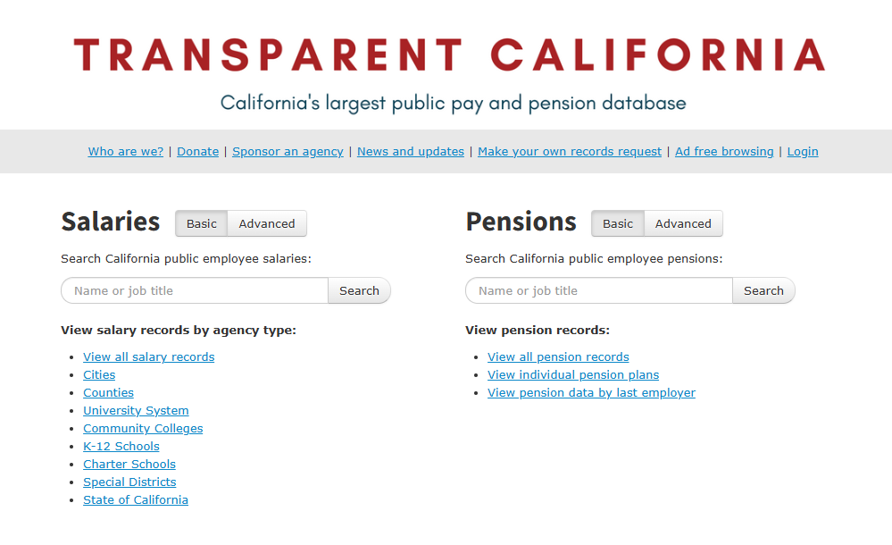
Data Sources
Gov. Compensation California
Transparent California

Slide 4

Data Caveats
Dataset: 2023 GCC City
"Missing Data" on City & County maps
Missing Counties: 3 (Alpine, Mariposa, Trinity)
Missing Cities: 14 (Amador City, Firebaugh, Bradbury, Hidden Hills, La Cañada Flintridge, Point Arena, Mountain House, Paso Robles, Atherton, Colma, Dorris, Mount Shasta, Tehama, Ventura)
Cities vs Towns vs "Unincorporated Area"
Separating / Classifying this from GeoData is difficult
No current geojson/shapefile for this

Slide 5
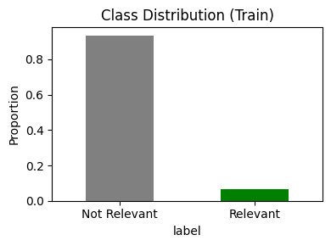
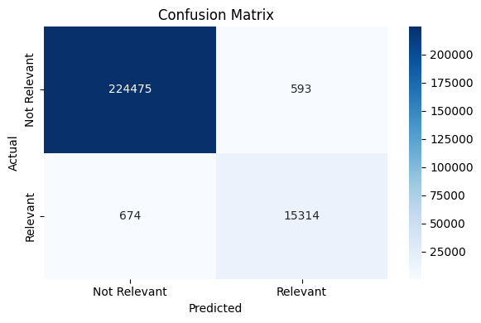
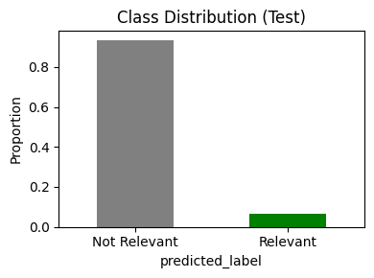
Relevance
Training Set = 103,310 positions
Test Set = 241,056 positions
Filtered Set ~ 15k – 22k Relevant Positions
Notes:
Confusion Matrix based off test dataframe
F1-score 0.9603

Slide 6
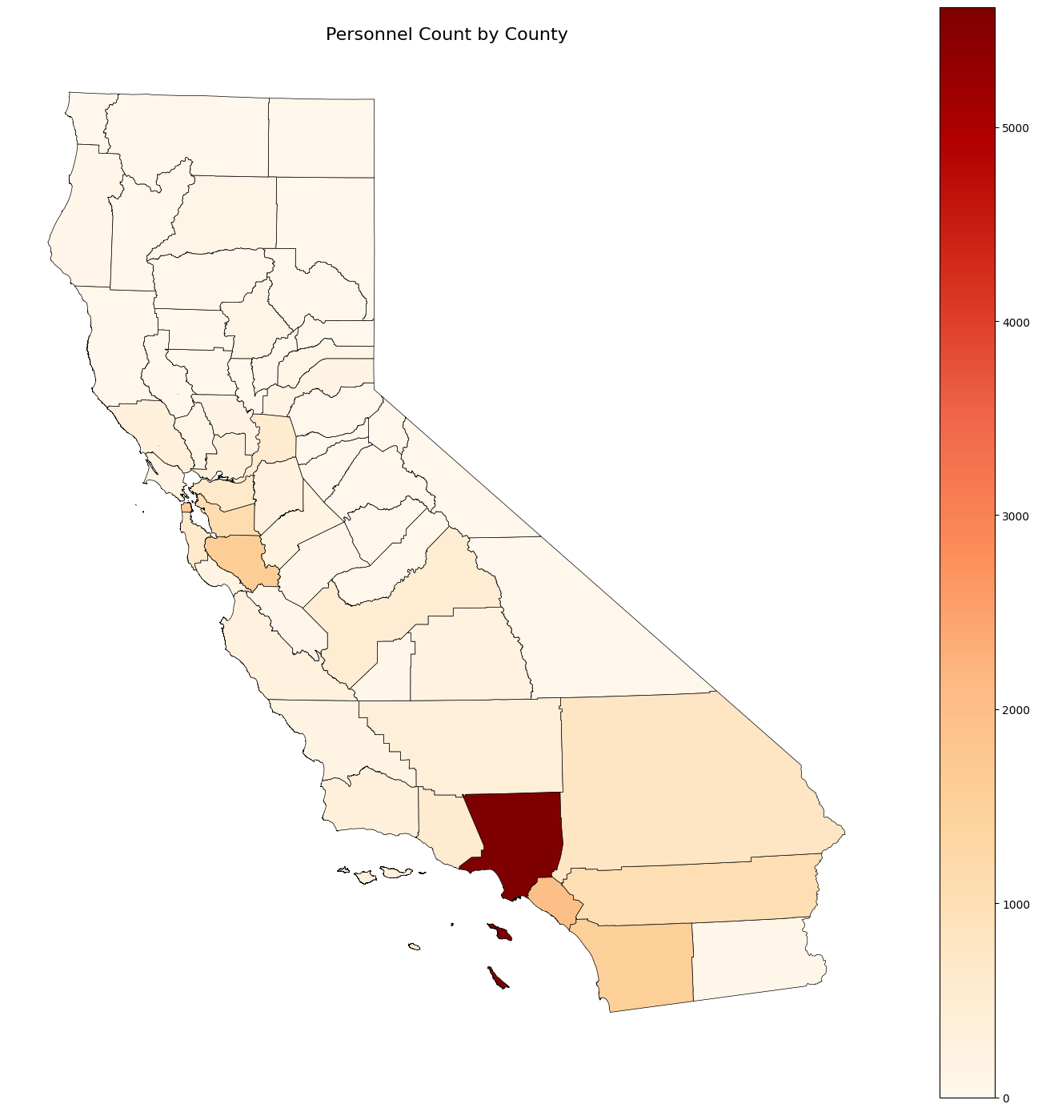
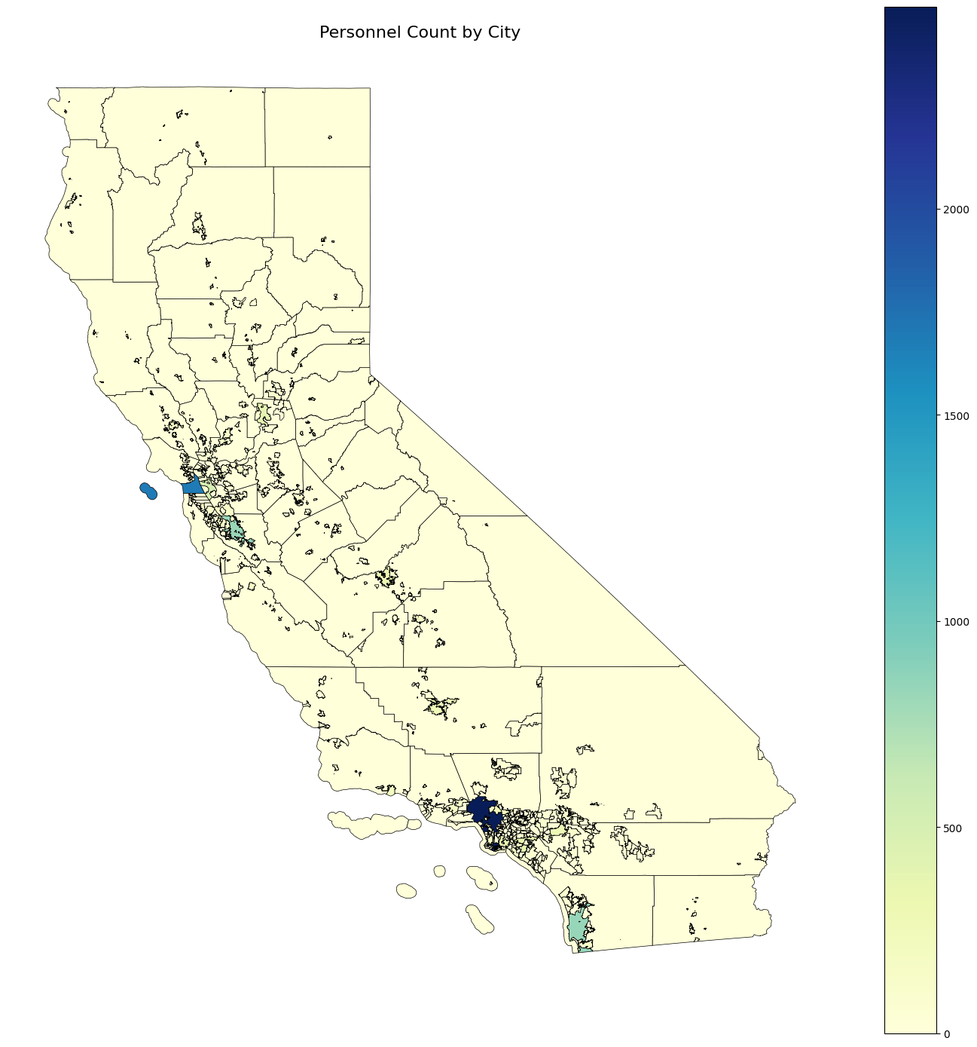
Results: Base
Notes:
Confusion Matrix based off test dataframe
F1-score 0.9603

Slide 7
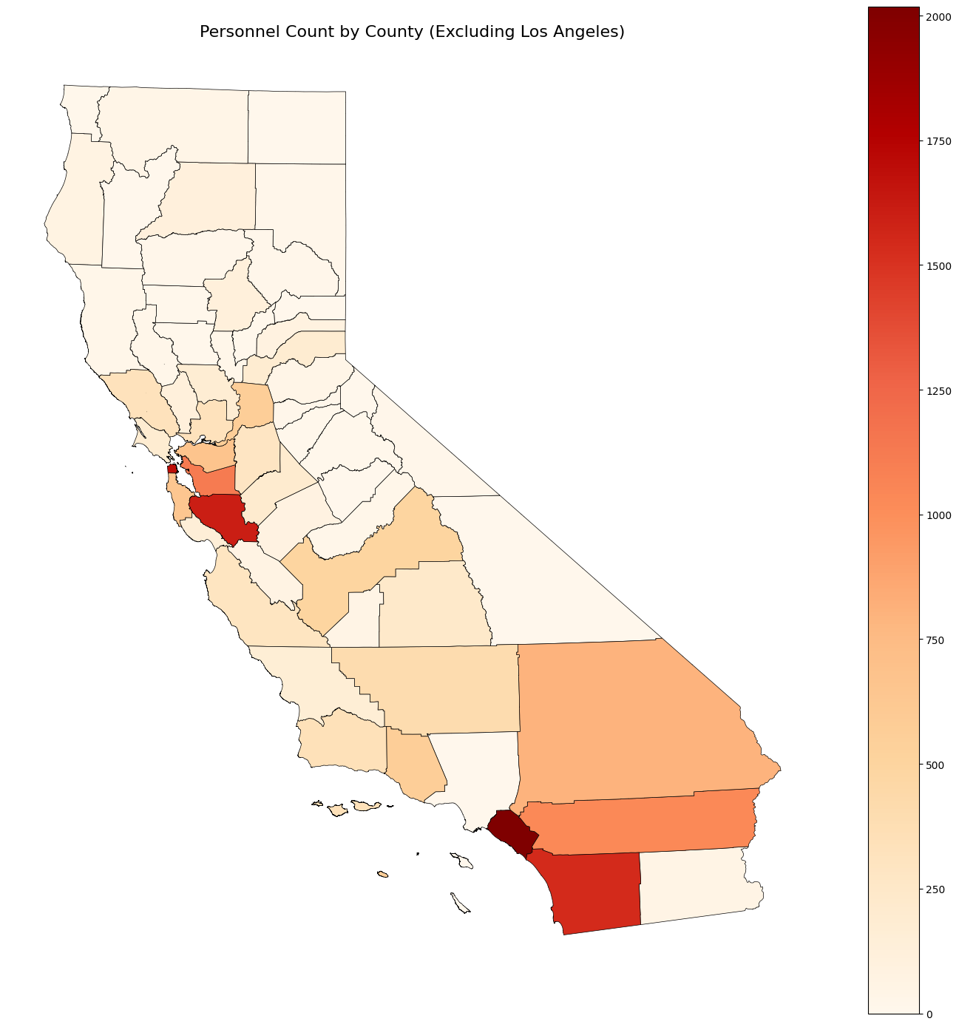
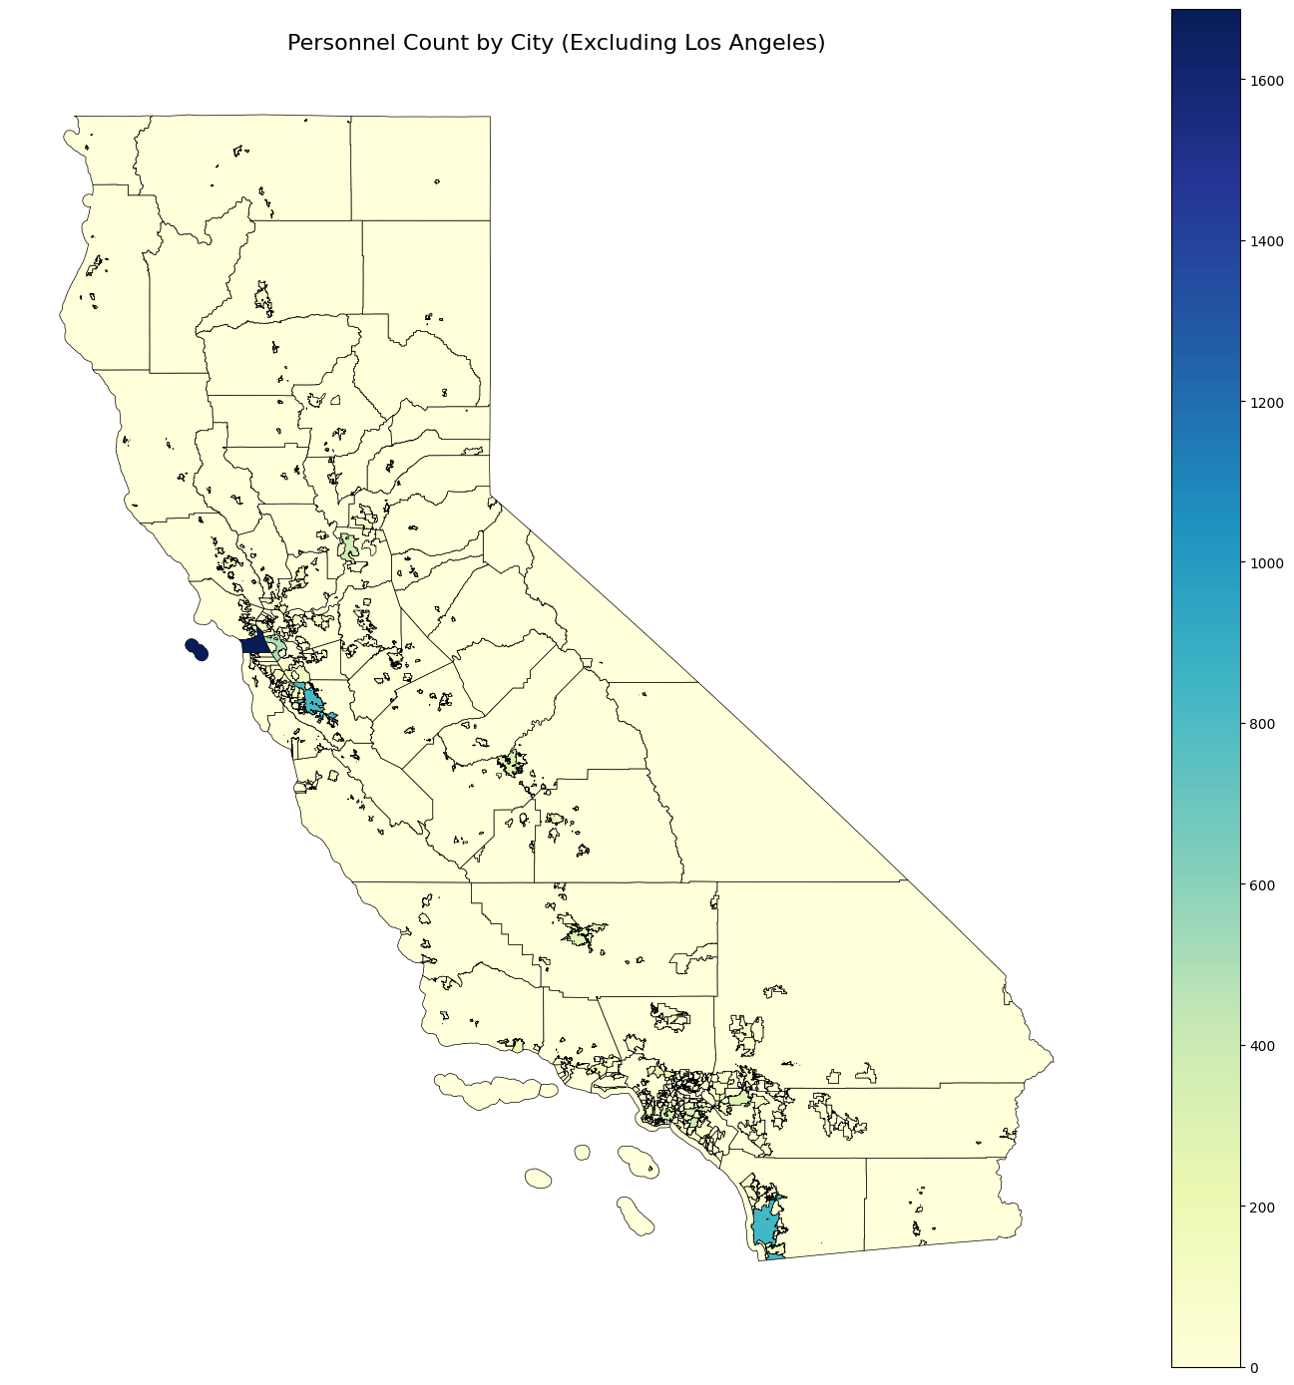
Results: Filtered
Notes:
Confusion Matrix based off test dataframe
F1-score 0.9603

Slide 8
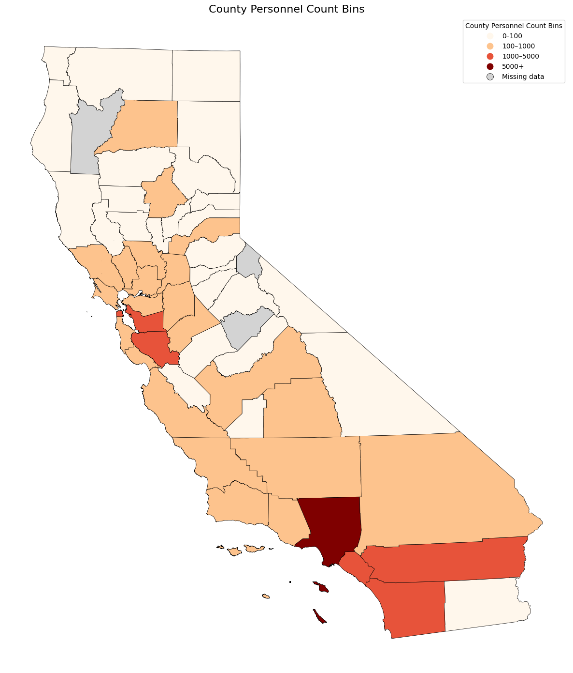
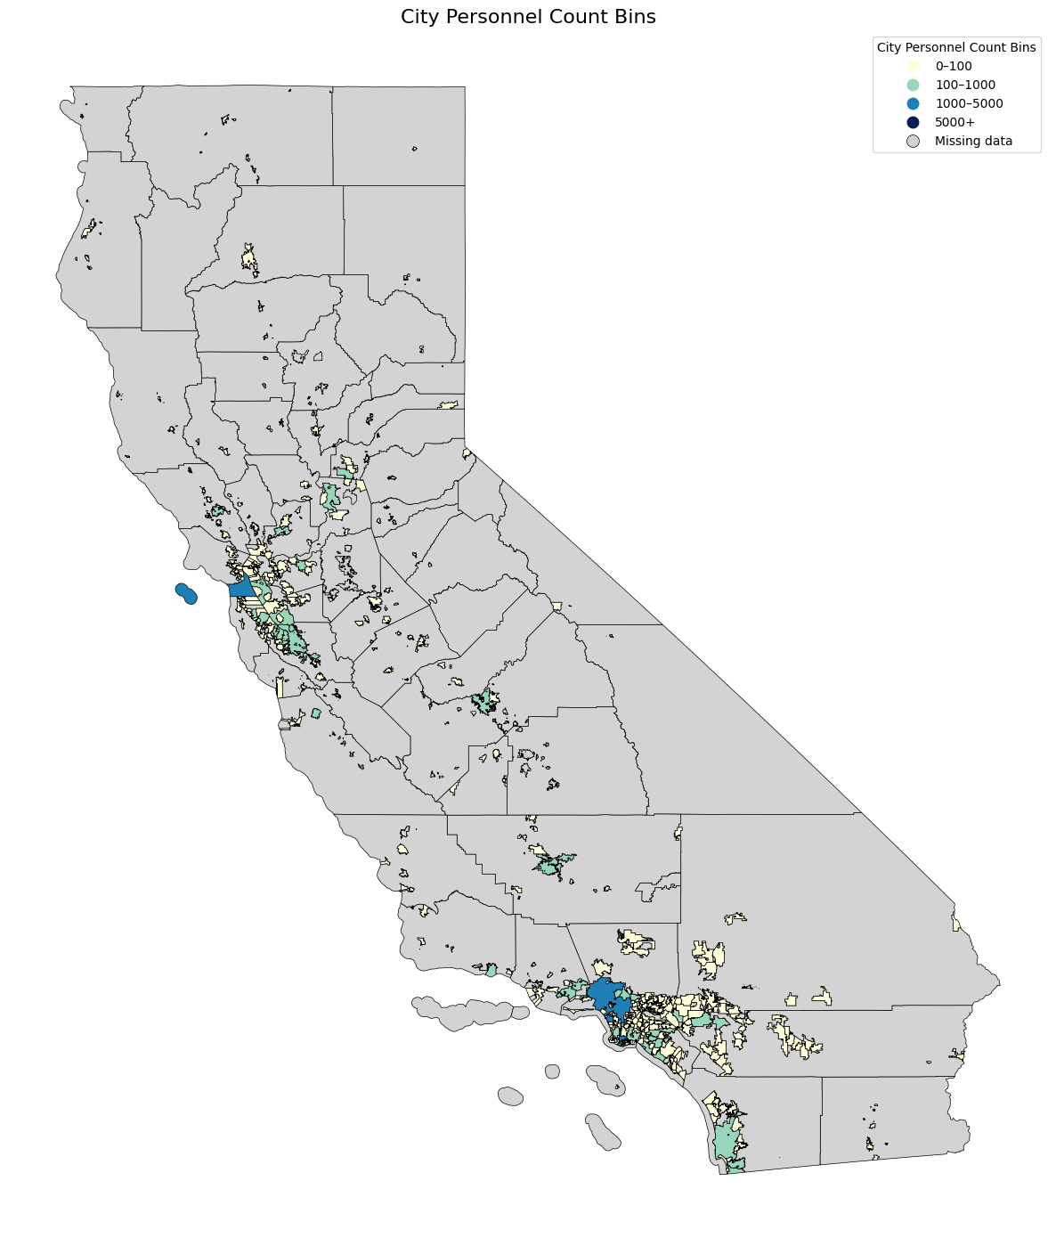
Results: Binned
Notes:
Confusion Matrix based off test dataframe
F1-score 0.9603

Slide 9

Recommendations and Next Steps
More robust sourcing and verification of personnel for actual AHJ / Building Department representation
Gap #1 – Practical Gap
Allocating specific resources to cover cities / counties with low data representation
Gap #9 – Data Gap
Lengthy process, start sooner than later
Gap #18 – Data Gap
Gap #20 – Data Gap
Notes:
Gap #1: The CEC must collect data manually from AHJs.
Gap #20: Sampling challenges are significant risks to uncertainty of results and credibility.
Gap #9: Limited compliance investigation coverage in rural service.
Gap #18: Higher quality permit data is required.

Slide 10
Thank You!

Slide 11
Slide Layout 5

